Slide 1

Twitter Bot
Rachael, Nicole, Dionysis, Stuart, Rory

Slide 2
Technical details

Slide 3
Test coverage

Slide 4
Technical/teamwork struggles

Slide 5
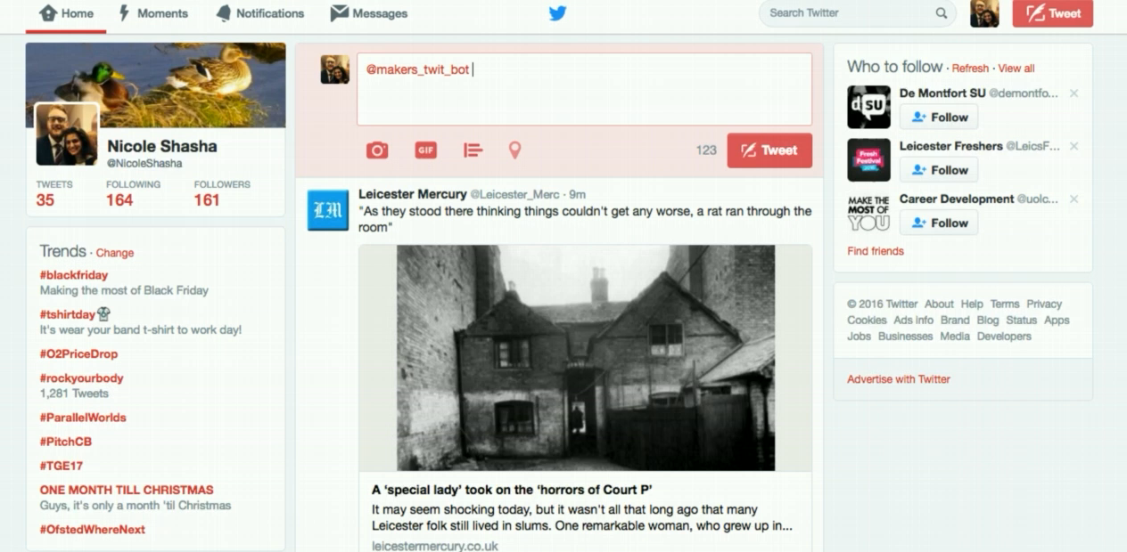
In action

